Slide 1


Instructor Resources
Chapter 14 Figures
Cover photo: BeautyStock – stock.adobe.com.

Slide 2
Chapter 14
Hazard Avoidance Systems

Slide 3
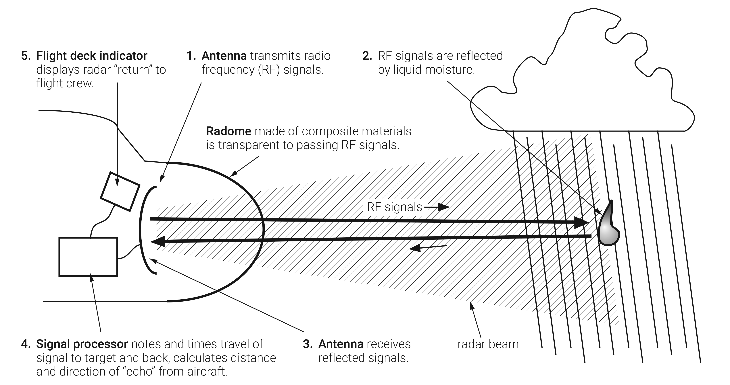
FIGURE 14.1
How radar works.

Slide 4
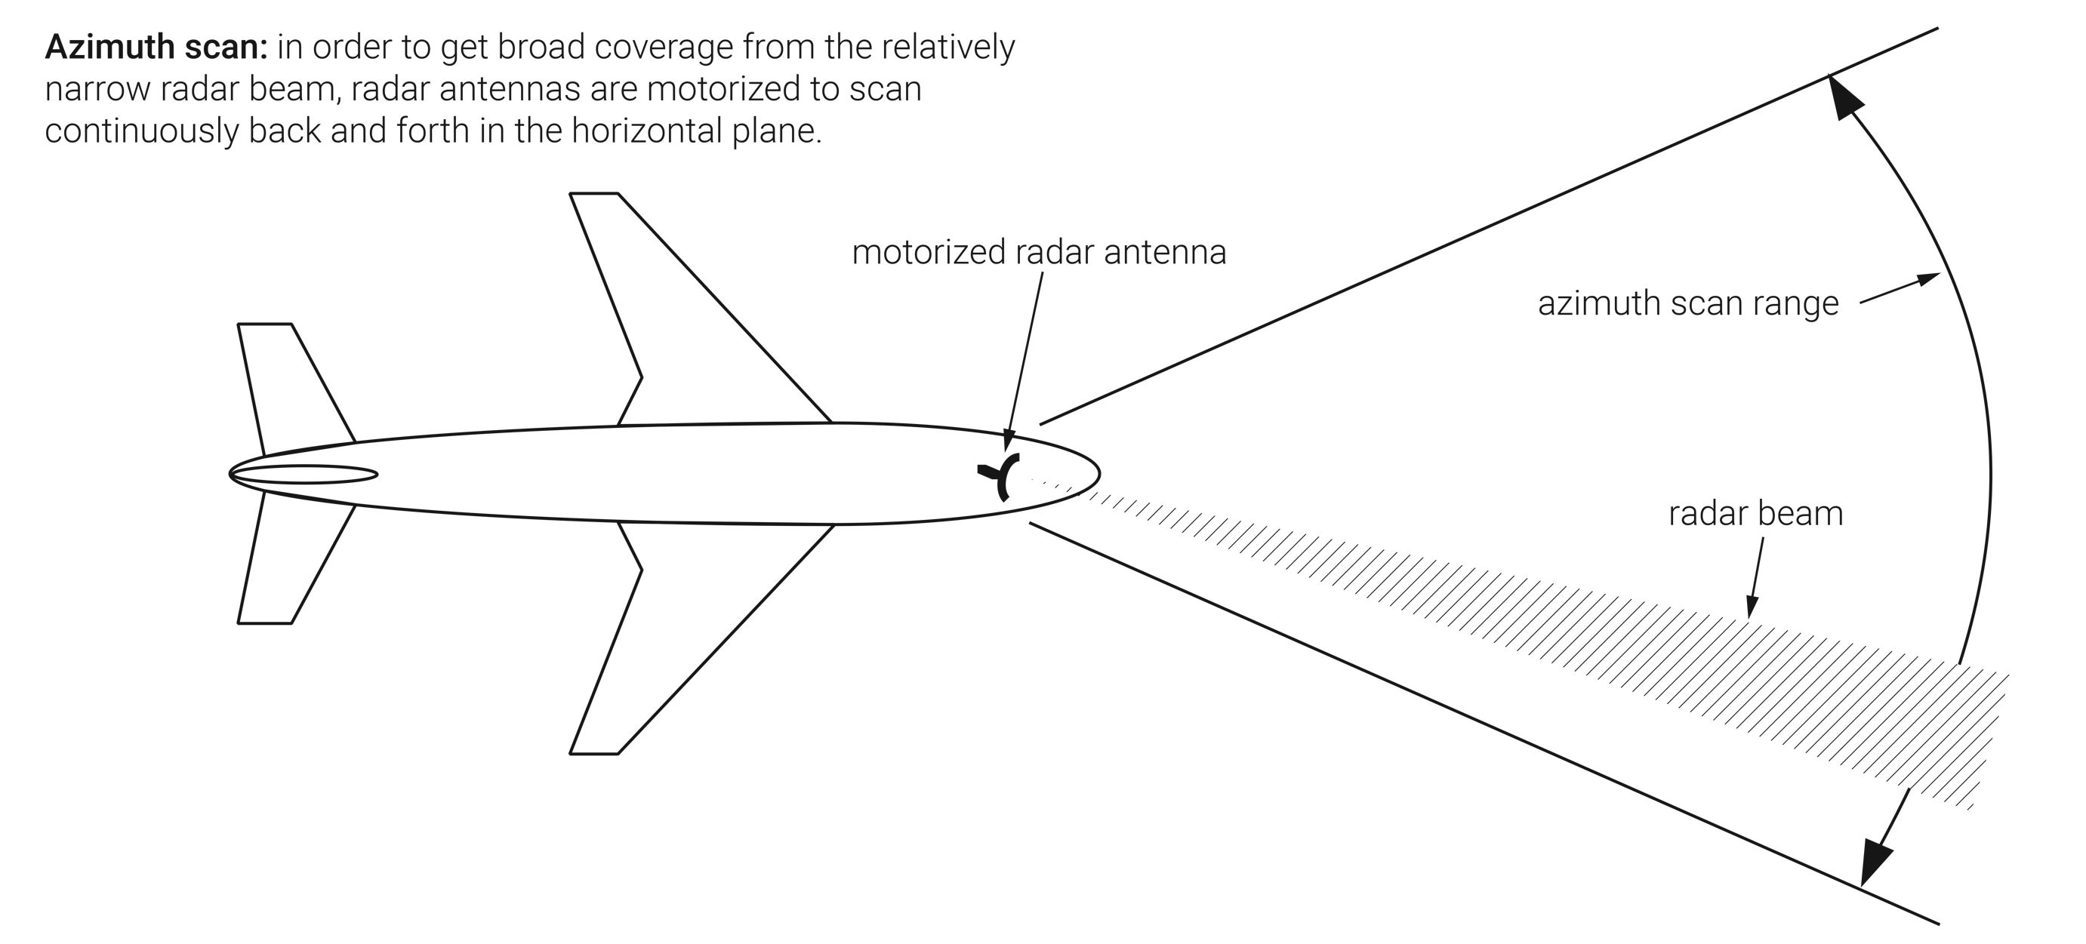
FIGURE 14.2
Azimuth scan.

Slide 5
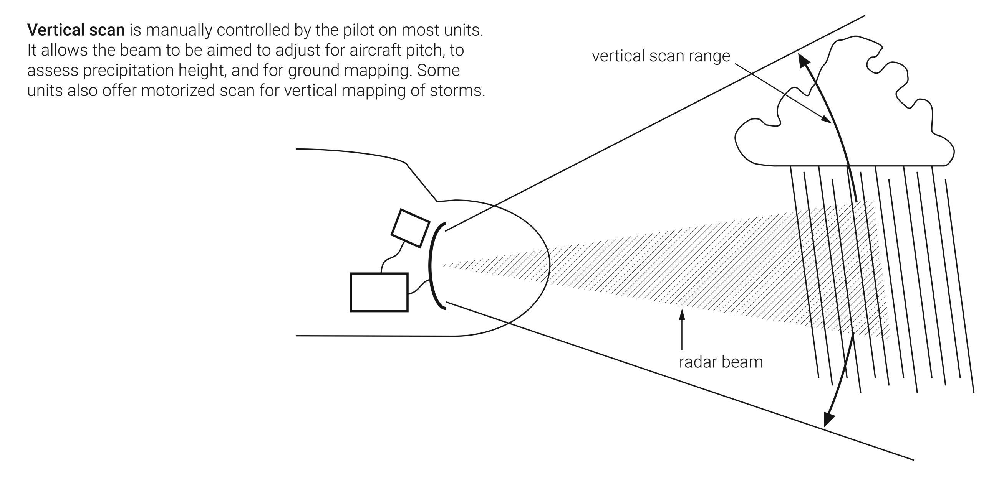
FIGURE 14.3
Vertical scan.

Slide 6
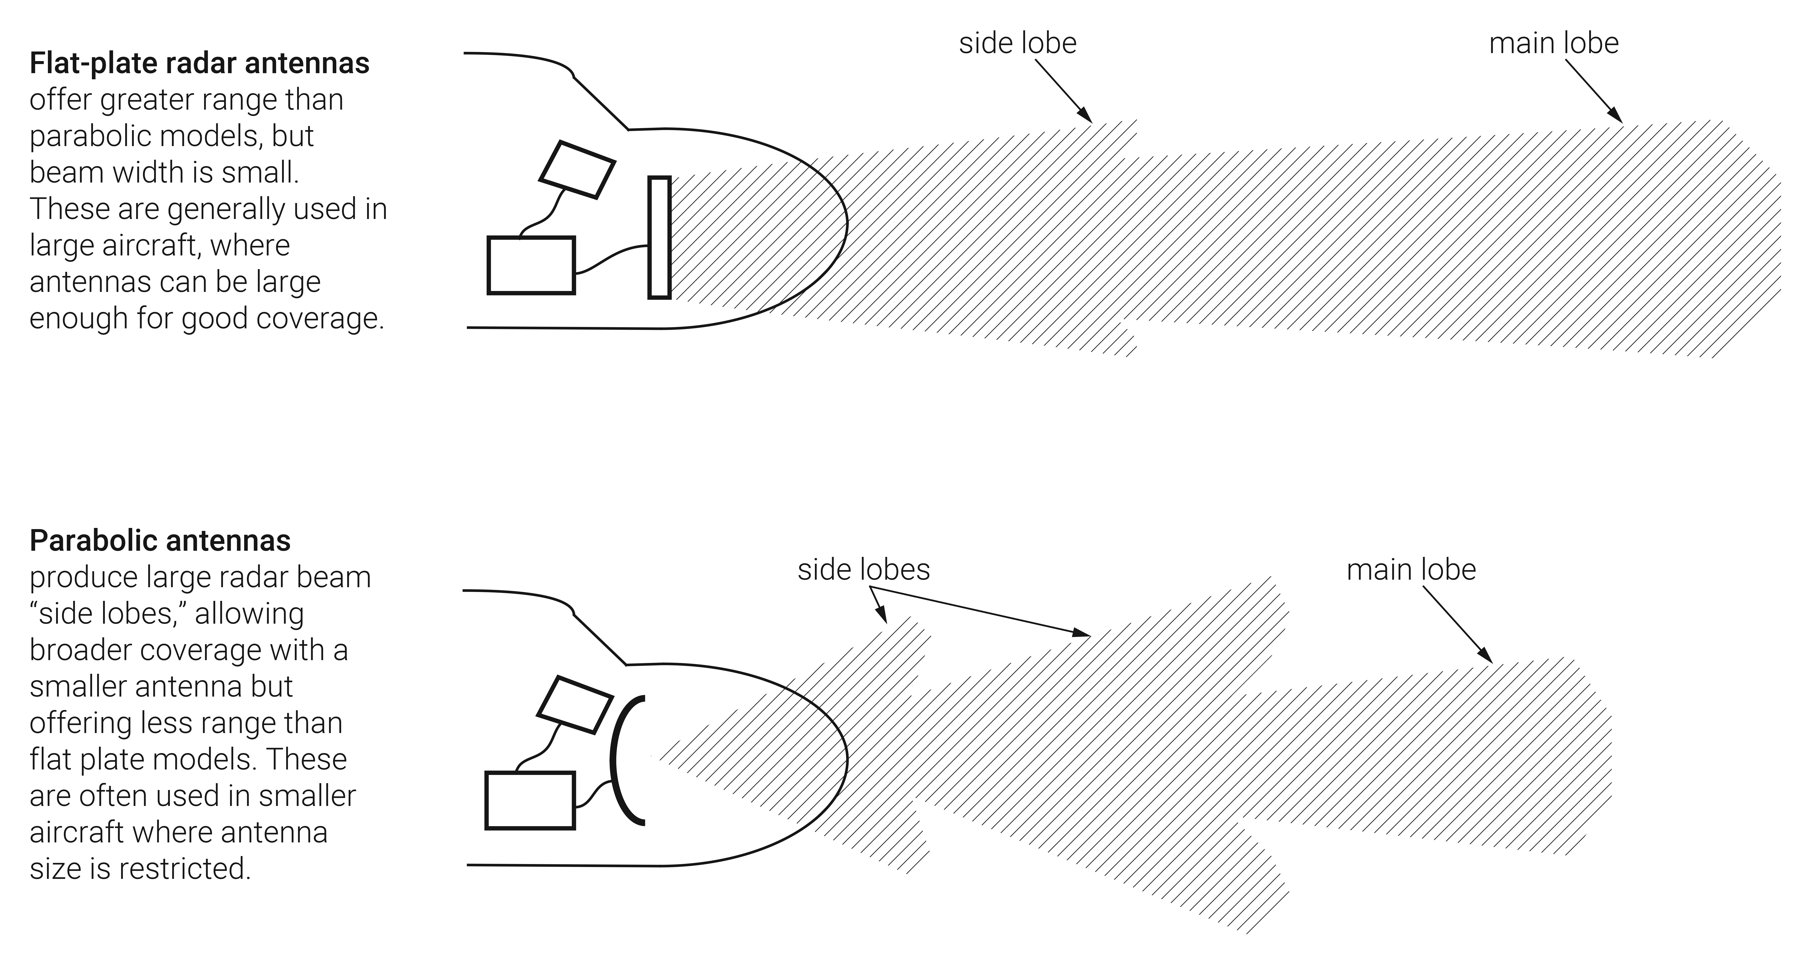
FIGURE 14.4
Radar antenna types.

Slide 7
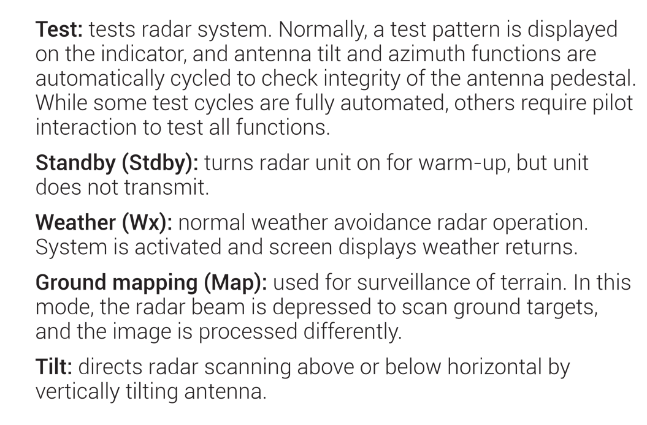
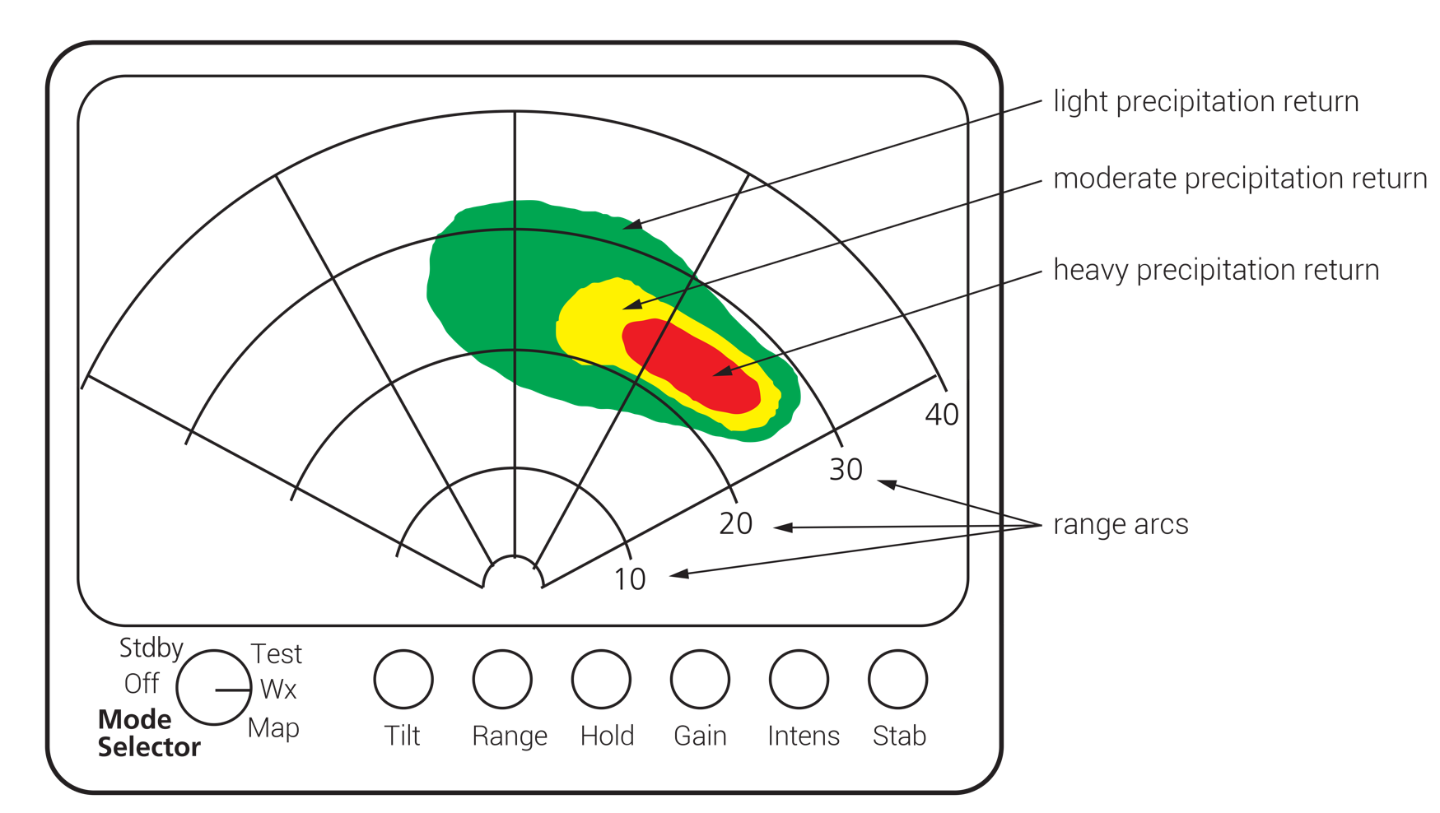
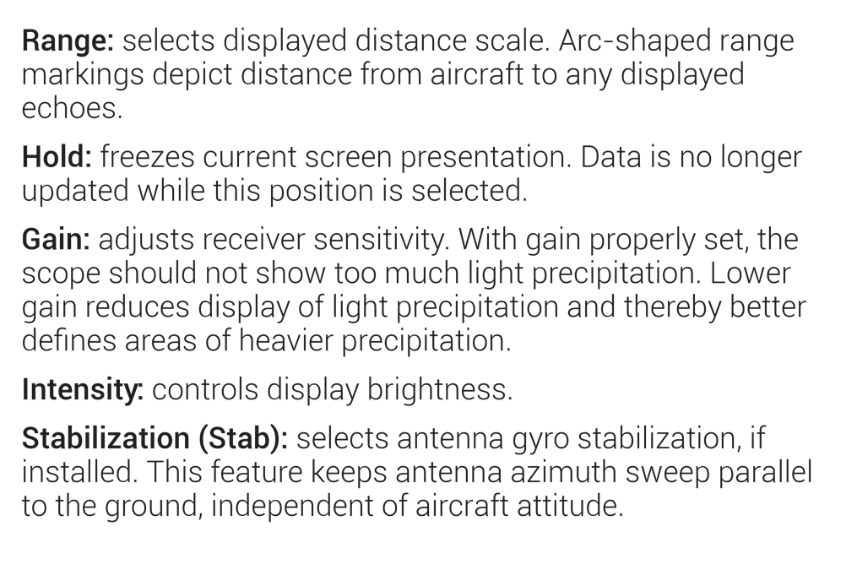
FIGURE 14.5
Typical radar display and control functions.

Slide 8
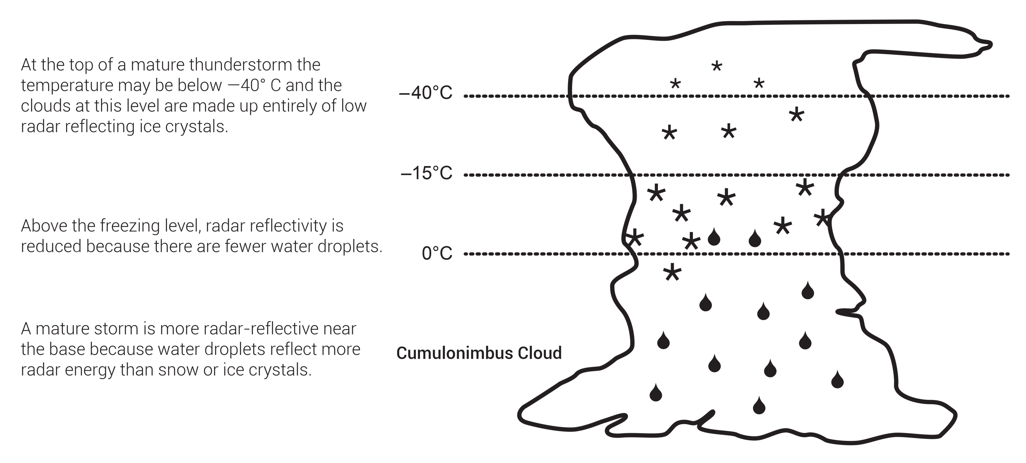
FIGURE 14.6
Radar reflectivity of a thunderstorm.

Slide 9
FIGURE 14.7
Precipitation gradients.

Slide 10
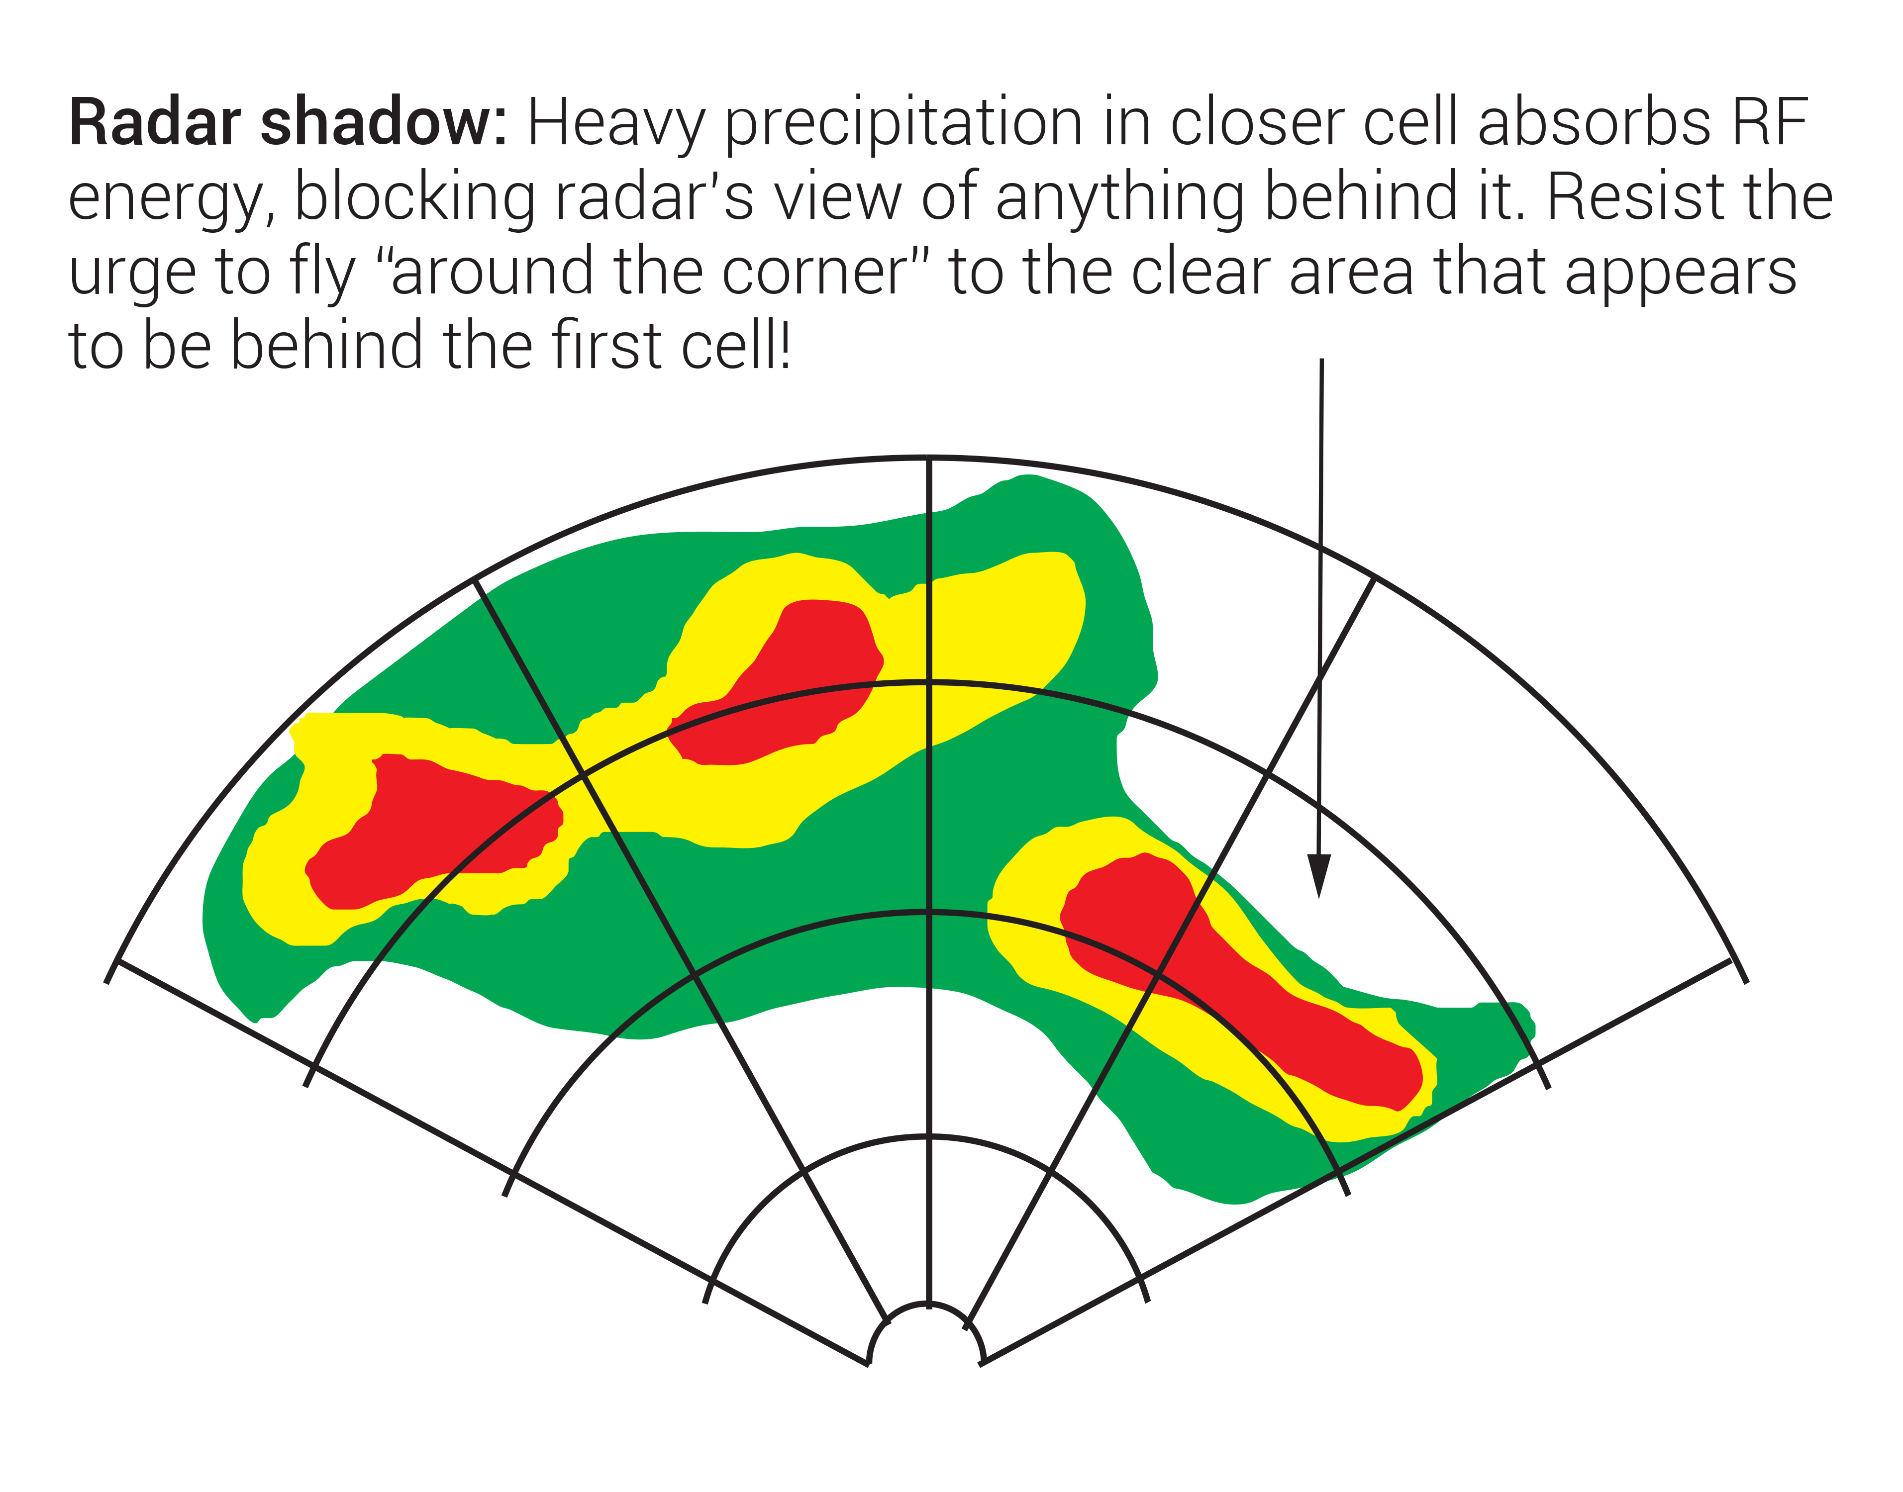
FIGURE 14.8
Radar shadow.

Slide 11
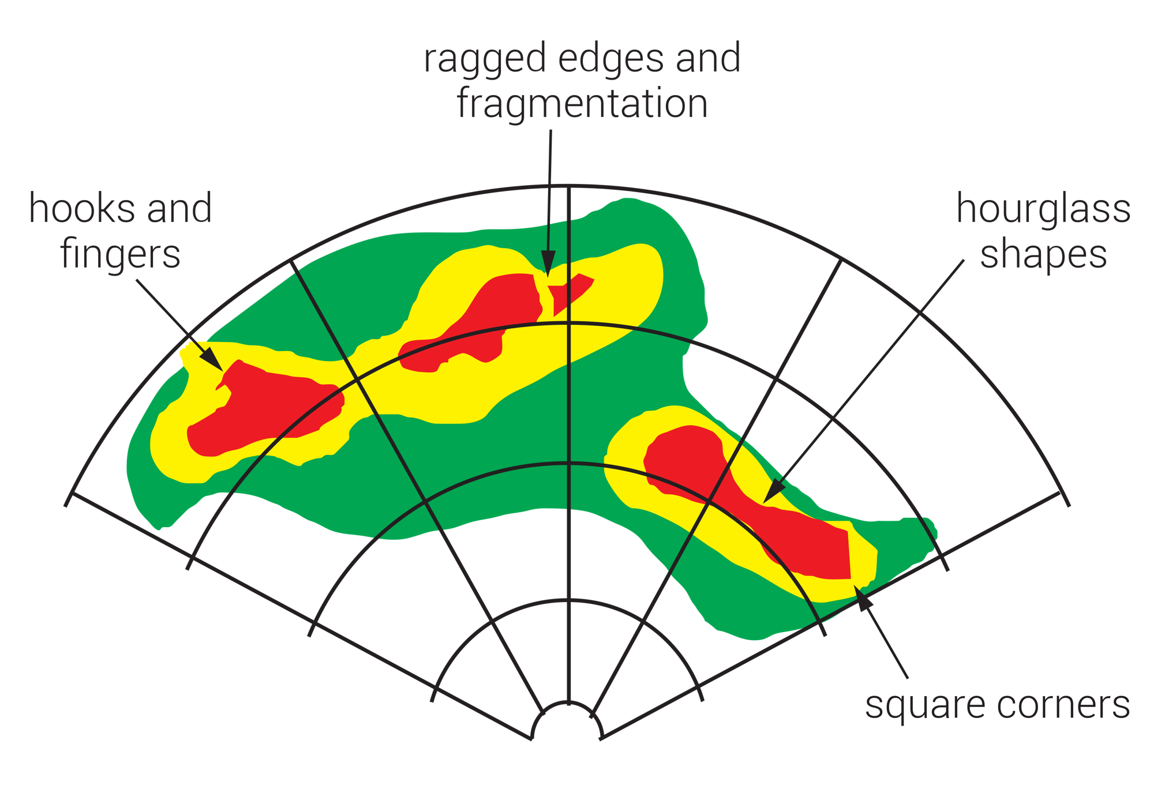
FIGURE 14.9
Unusual echo shapes to avoid.

Slide 12
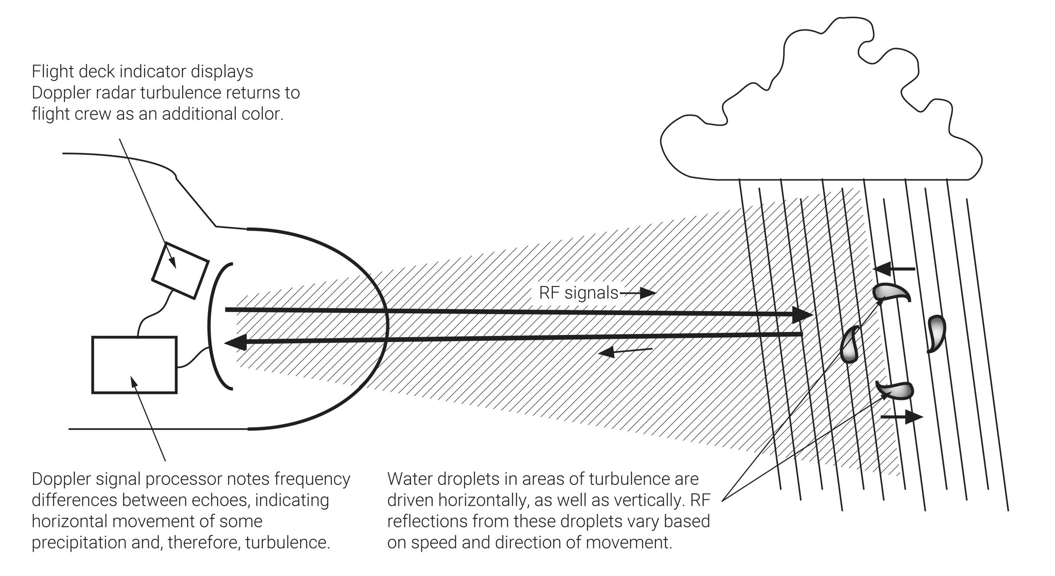
FIGURE 14.10
How Doppler radar works.

Slide 13
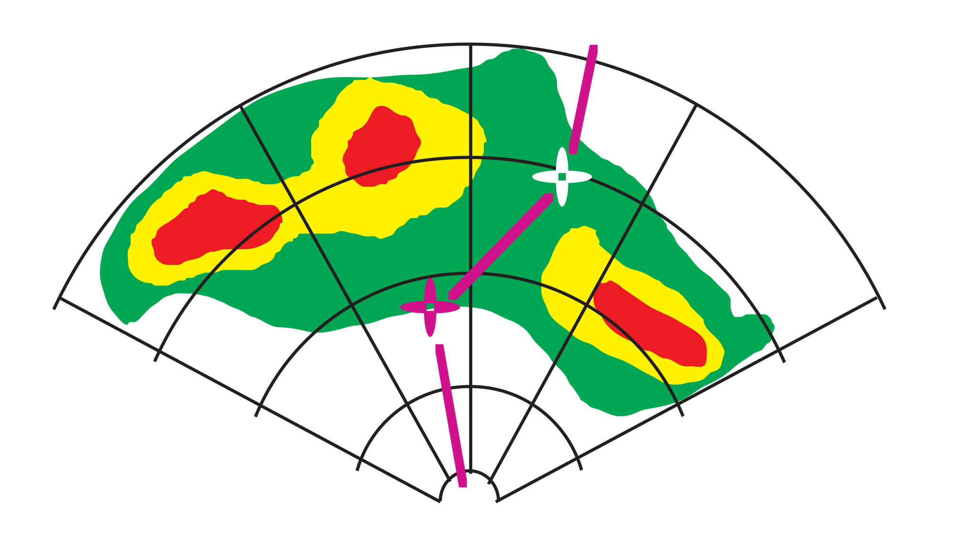
FIGURE 14.11
Radar display showing area navigation (RNAV) courseline.

Slide 14
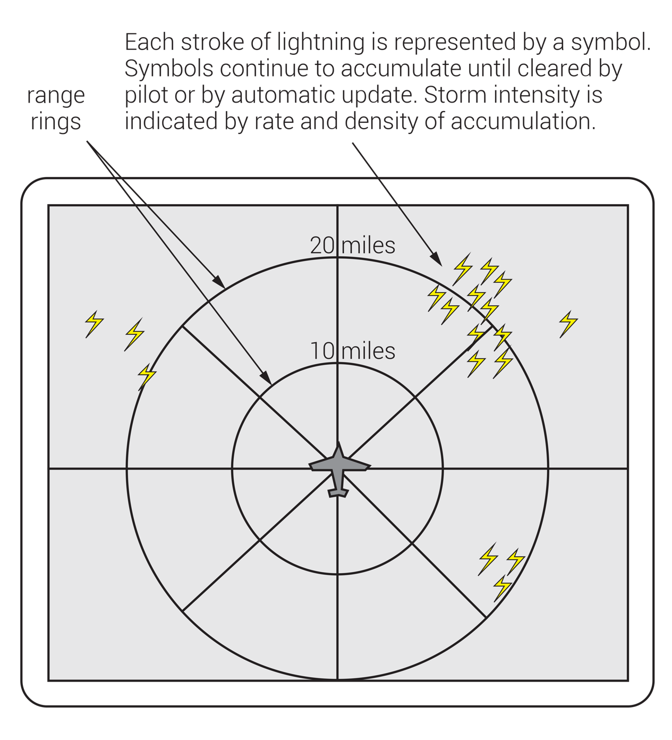
FIGURE 14.12
Electrical discharge or lightning detectors.

Slide 15
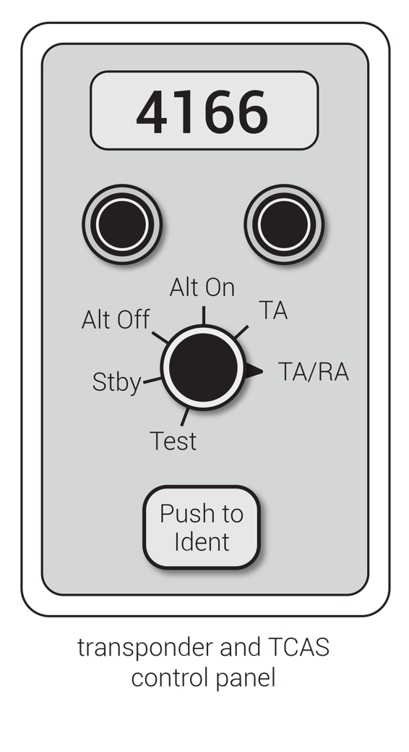
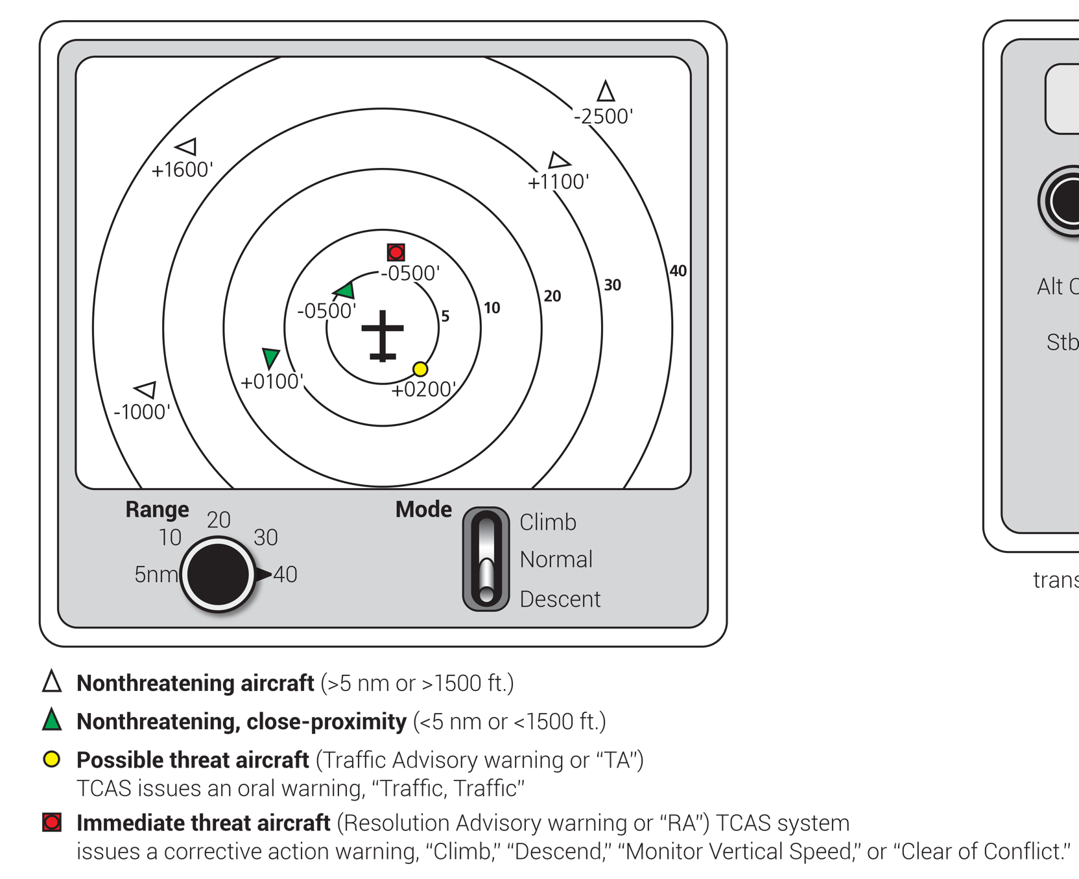
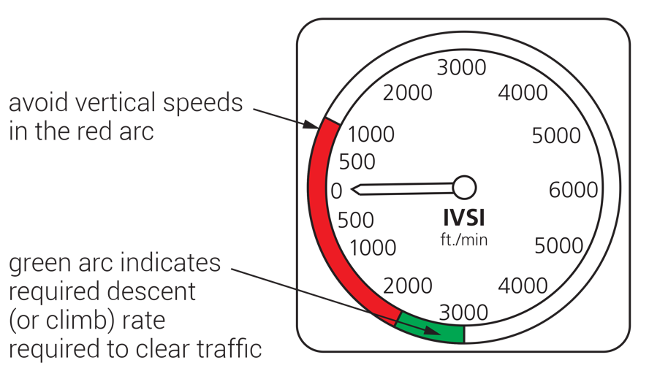
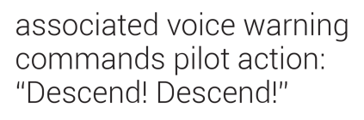
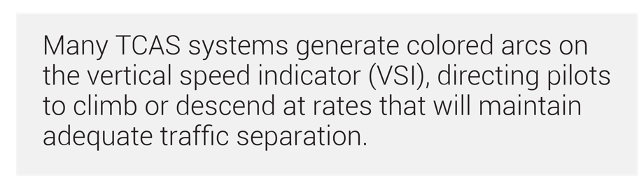
FIGURE 14.13
Traffic alert and collision avoidance system (TCAS).

Slide 16
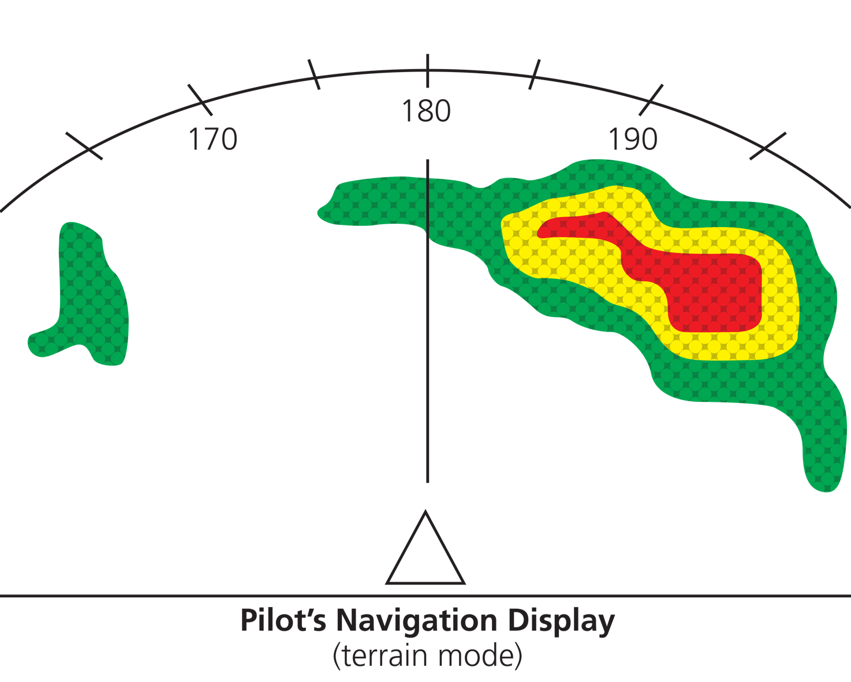
Green = –2000 ft. below to –500 ft. below aircraft
Yellow = –500 ft. below to +2000 ft. above aircraft
Red = +2000 ft. or more above aircraft
Clear = terrain more than 2000 ft. below aircraft
(Exact depiction and altitudes vary by manufacturer and flight configuration.)
Note: terrain displayed in altitude difference from aircraft’s current altitude.
FIGURE 14.14
Enhanced ground proximity warning (EGPWS) terrain display.

Slide 17
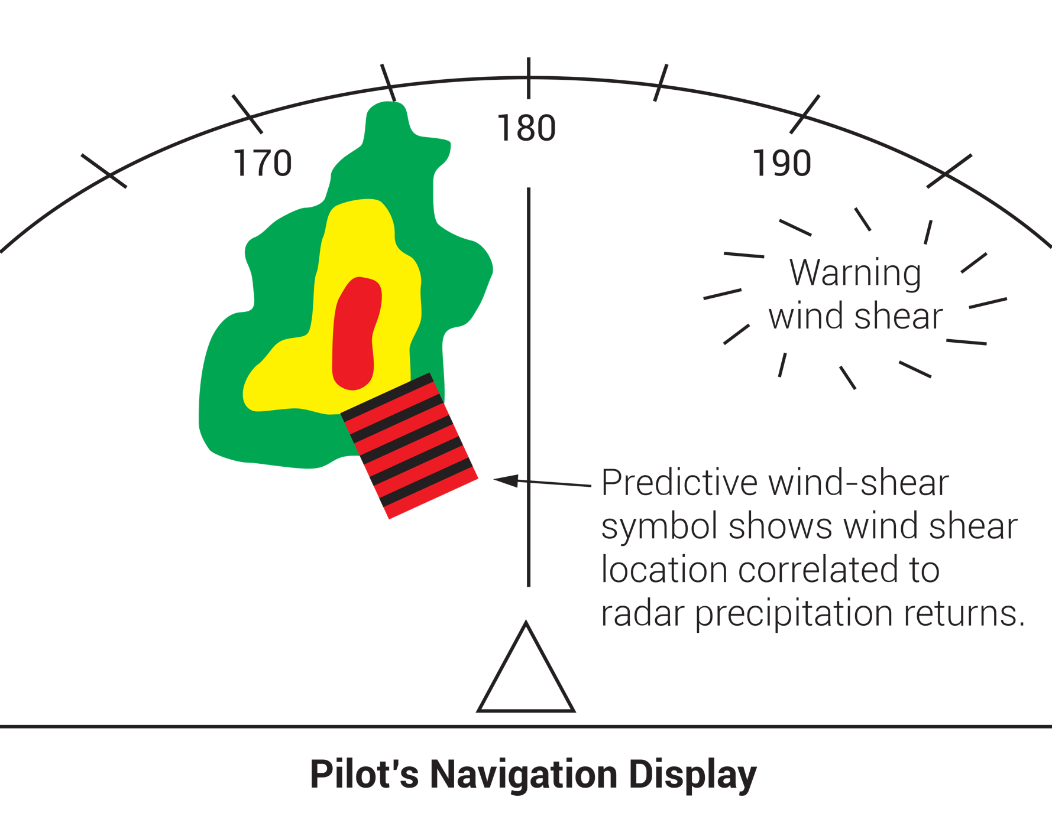
FIGURE 14.15
Predictive wind-shear warning system (PWS) display.

Slide 18
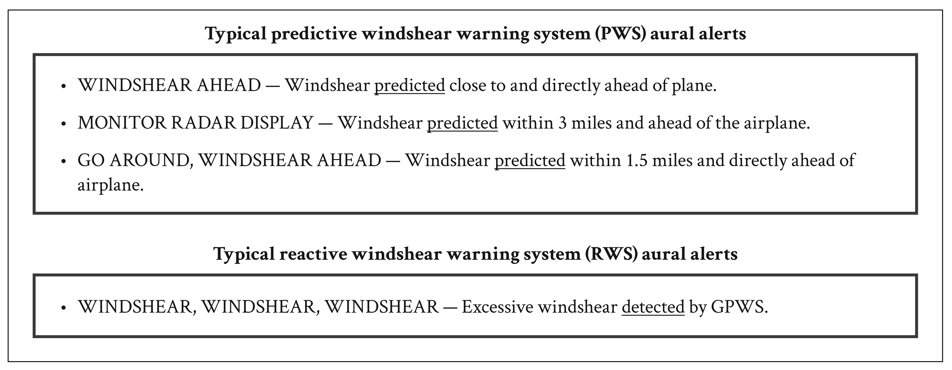
FIGURE 14.16
Typical wind shear warning systems and aural alerts.

Slide 19
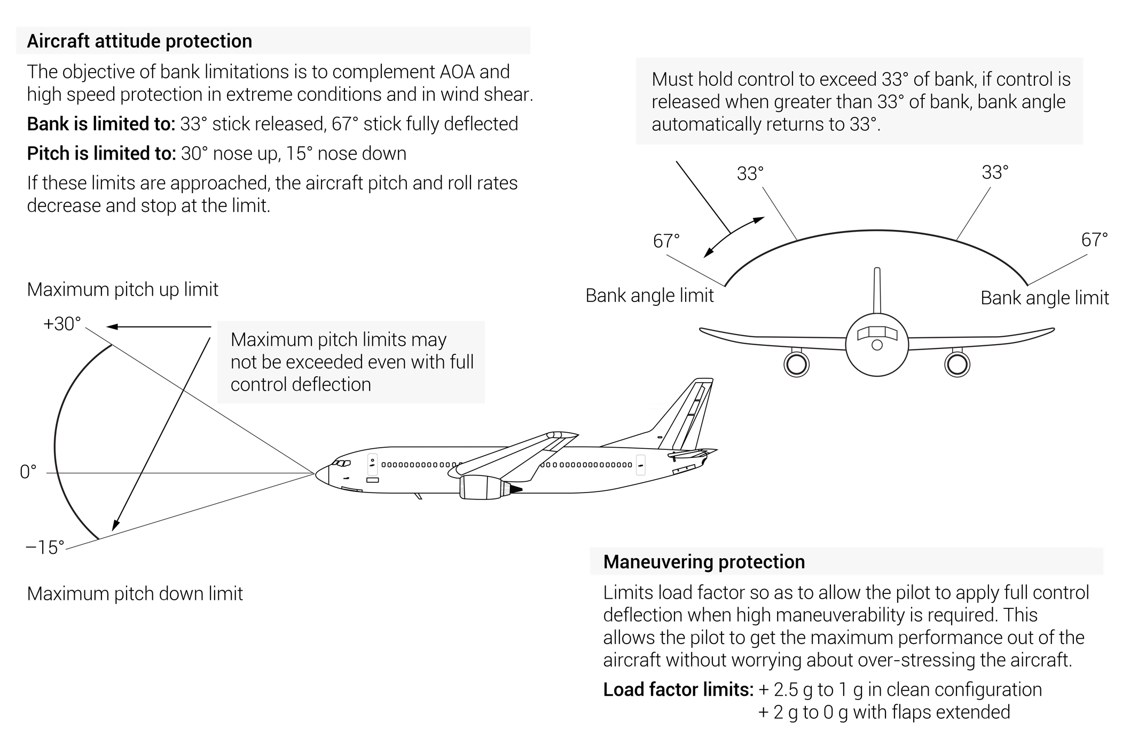
FIGURE 14.17
Flight envelope protection.

